Slide 1
FPGA - Snake Game
Louis Turriaga, James Hamm, Jordan Tejada, Triet Vo

Slide 2
Purpose and goals of project
Create a Snake game only using the Nexys A7
Utilize the built in VGA
Be able to adjust game speed using a potentiometer and the board’s XADC IP
Learn about FPGAs and how versatile they can be

Slide 3
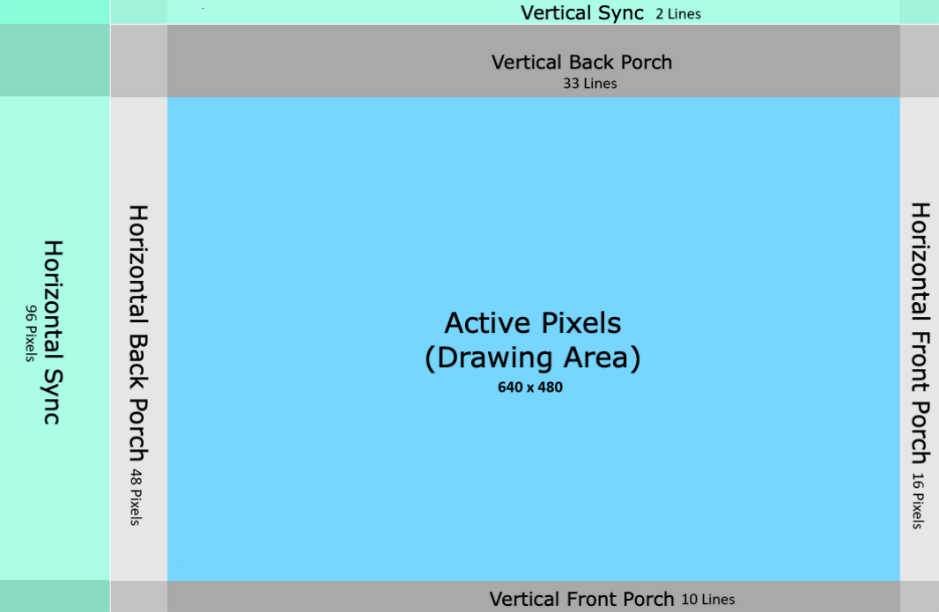
Display_Controller.v
Cycles through all pixels (Like reading a book)
Determines which pixels are in drawing area versus the blanking intervals
Manages visual timings and synchronization

Slide 4

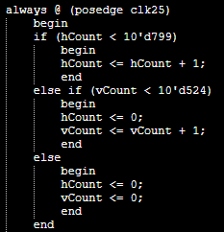
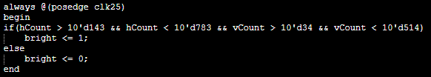
Display_Controller.v
Runs through each pixel coordinate on the screen
Monitors if the current position is in a sync zone
Sets the active pixels drawing area for Snake_Controller to use

Slide 5
Snake_Game.v
Sets the rules and logic of the game
Inputs:
Buttons corresponding to left, right, up, down, and start
Reset switch and game clock
Outputs:
8 1-bit one-hot encoded outputs corresponding to states of game (INIT, MOVE, CHECK, HOLD, EAT, WIN, LOSE, UNKN)
8-bit output for location of apple (8-bit for 256 locations)
4-bit output for snake size (4-bit for 16 snake parts)
128-bit output for locations of the 16 snake parts (16 appended 8-bit registers for 16 snake parts with 256 possible locations)

Slide 6
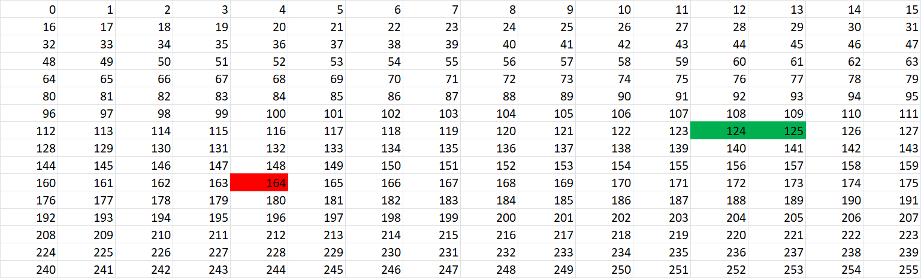
Snake_Game.v
States: INIT, MOVE, CHECK, HOLD, EAT, WIN, LOSE, UNKN (Each is triggered by an event in the game)
Display is separated into a 16x16 grid of possible locations the snake parts or apple can be:

Slide 7
Snake_Controller.v
Responsible for the outputted 12bit rgb data
Establishes the “Space” of the game pieces
Compares the hCount and vCount with these spaces
Snake
Apple
Border
20X20
20X20
10X10

Slide 8

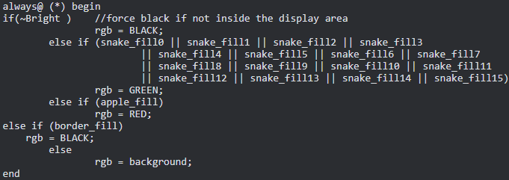
Snake_Controller.v
The Equation below is responsible for scaling and offsetting the game piece’s location in the 16x16 space. ->
The space of the game pieces is calculated by adding and subtracting the center by 10 both ways like so ->
Finally the color output is calculated:

Slide 9
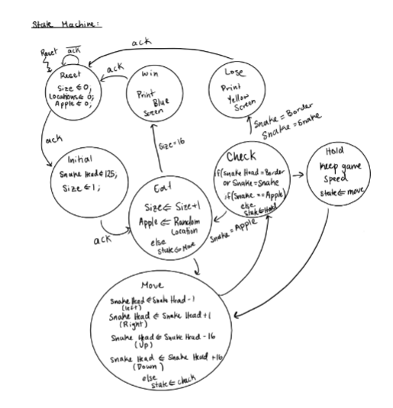
TOP.v
And outputs:
Seven segment display control lines
Anode controls
VGA signals
TOP.v module sews all the functioning modules together
Includes inputs:
The clock port
Button inputs
Switch input
Analog inputs

Slide 10
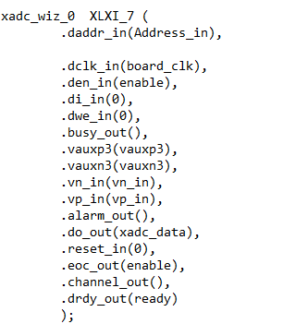
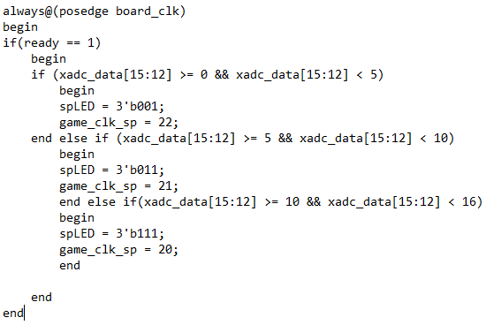
TOP.v (continued)
XADC changes difficulty of the game
‘xadc_wiz_0’ instance
Analog-to-digital conversion
Allows user to adjust the snake’s speed
Uses potentiometer
Switch LEDs of FPGA also adjusts according to difficulty

Slide 11
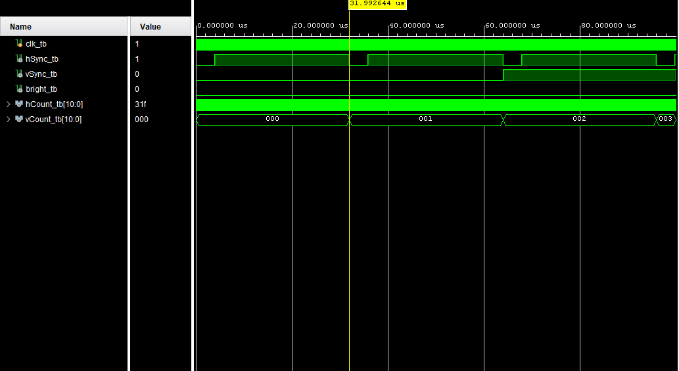
Test benches - Display Controller

Slide 12
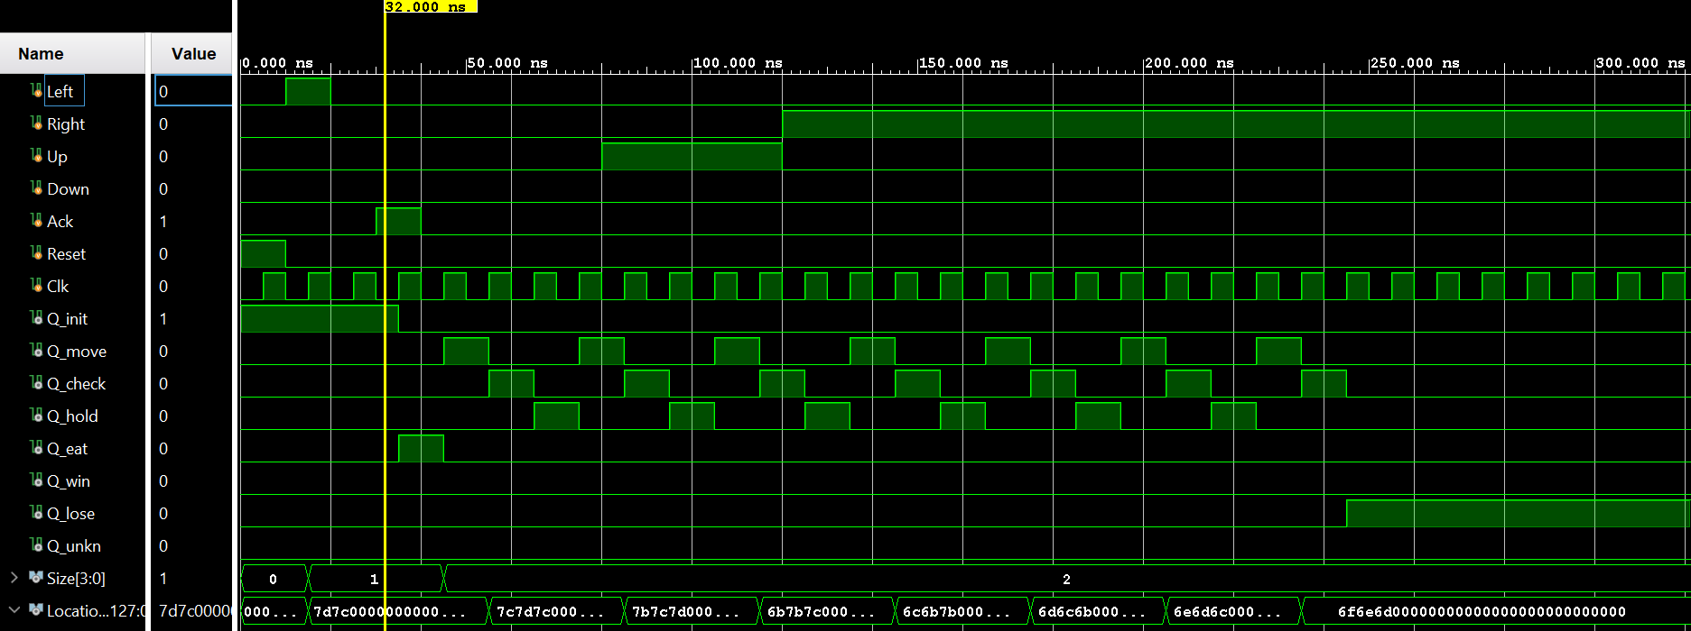
Test benches - Snake Game

Slide 13
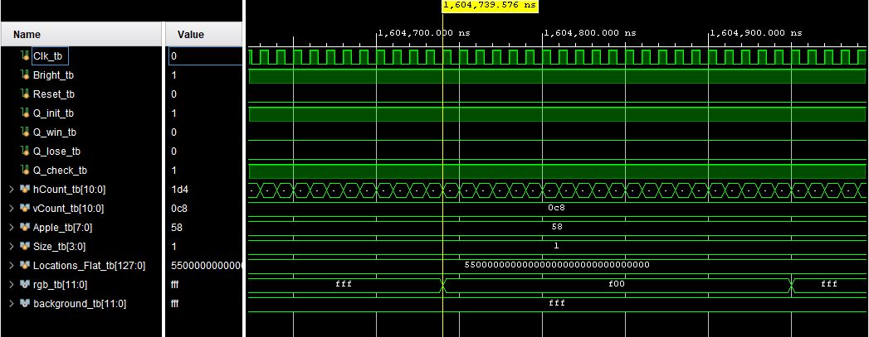
Test Benches - Snake Controller

Slide 14
